Slide 1
Elegant optimization

Slide 2
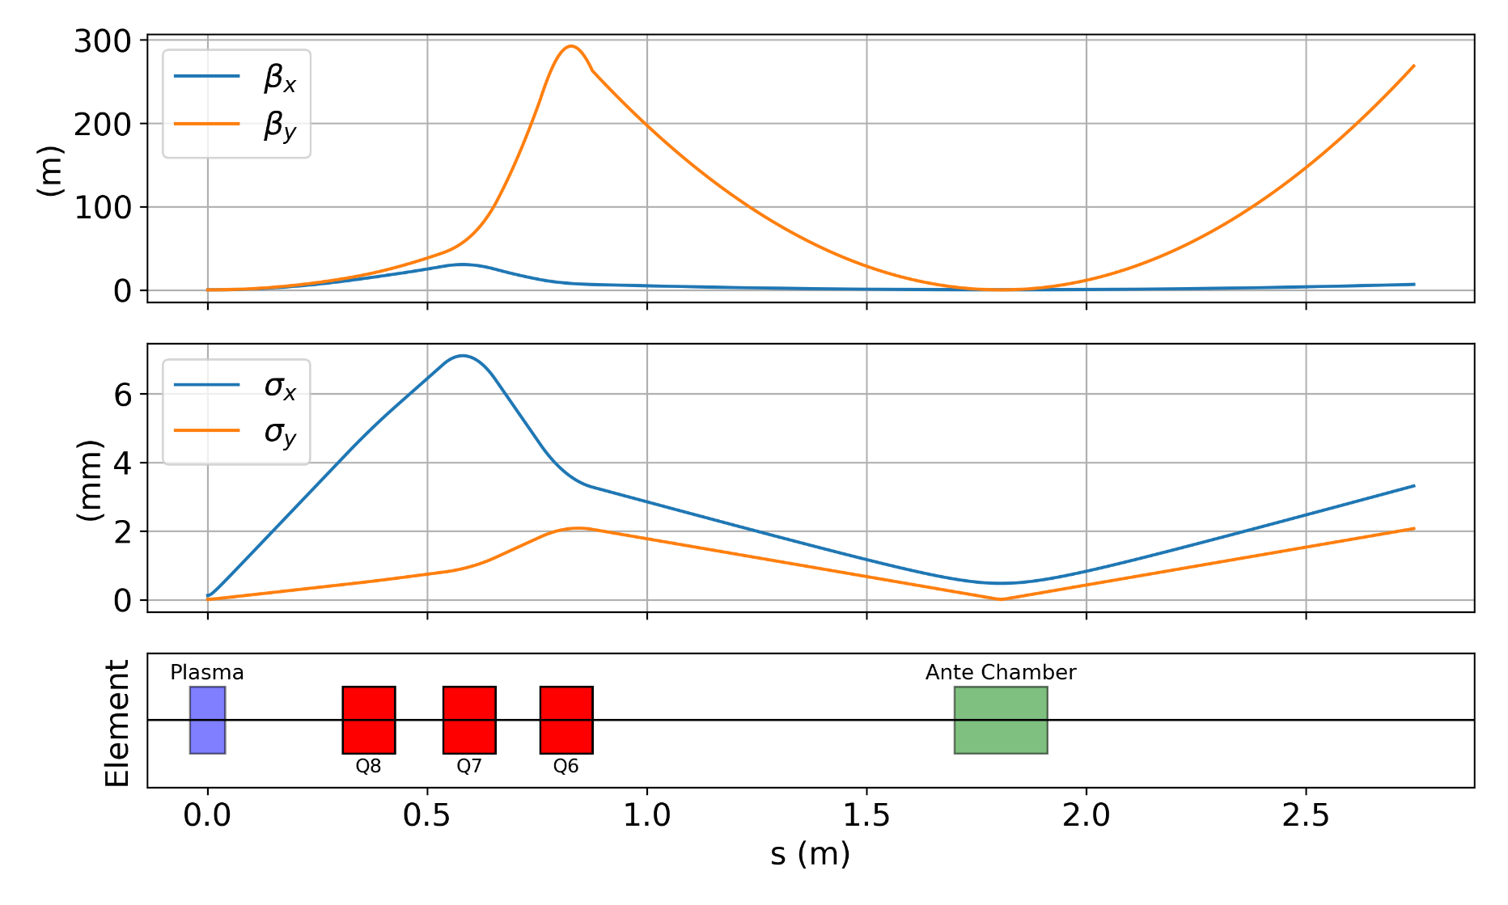
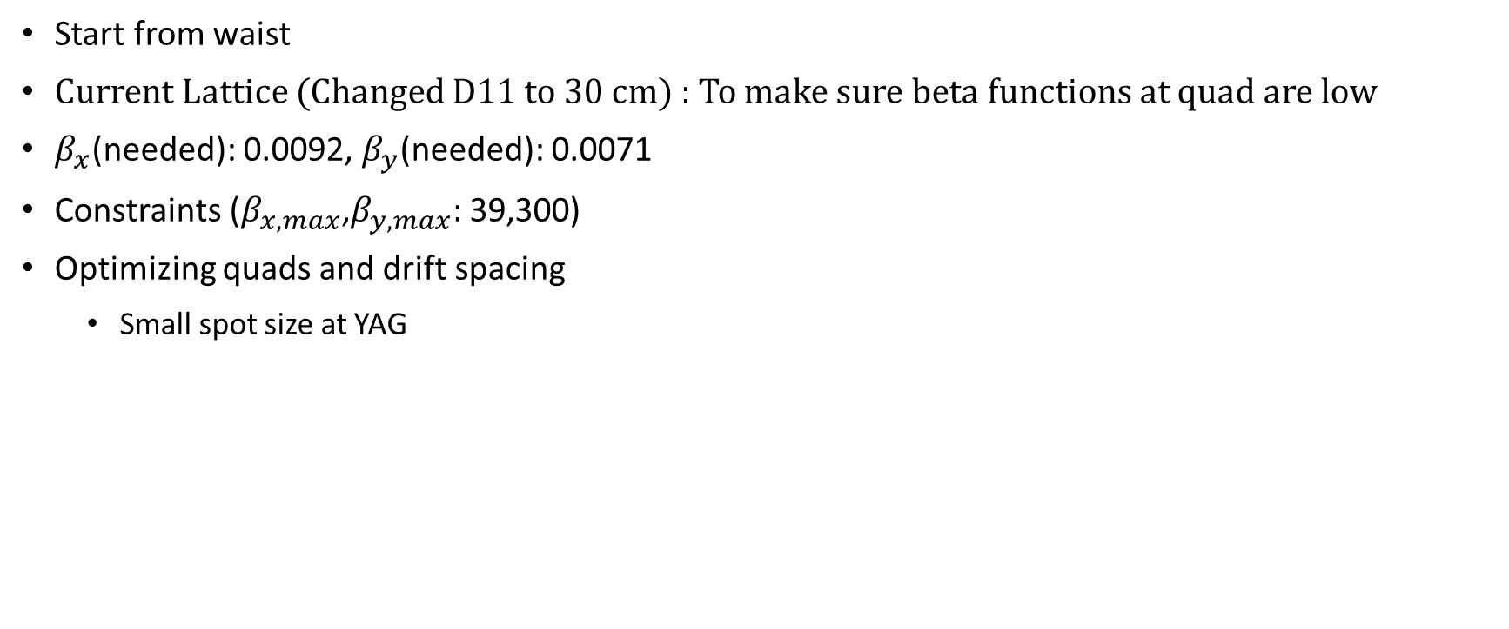
Reverse : Run 1-2
Start from waist
Current Lattice (Changed D11 to 30 cm) : To make sure beta functions at quad are low
$β_{x}$(needed): 0.0092, $β_{y}$(needed): 0.0071
Constraints ($β_{x,max}$,$β_{y,max}:$ 39,300)
Optimizing quads and drift spacing
Small spot size at YAG
YAG

Slide 3
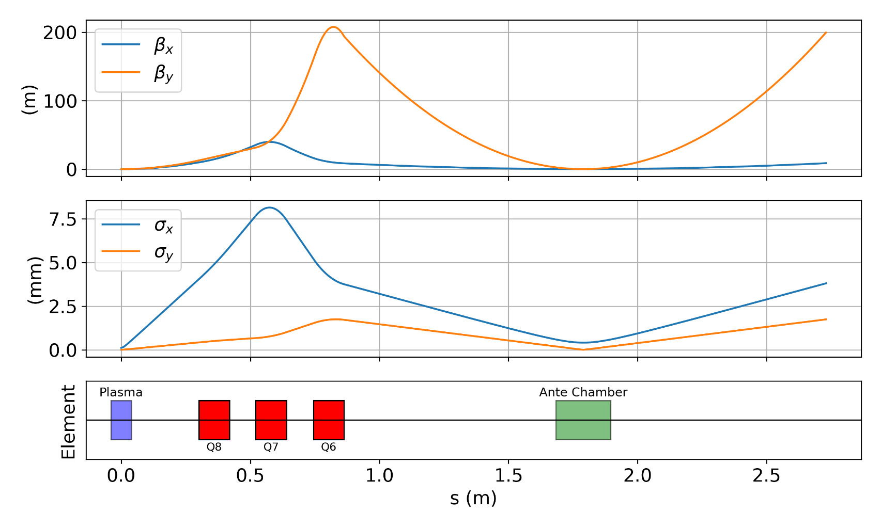
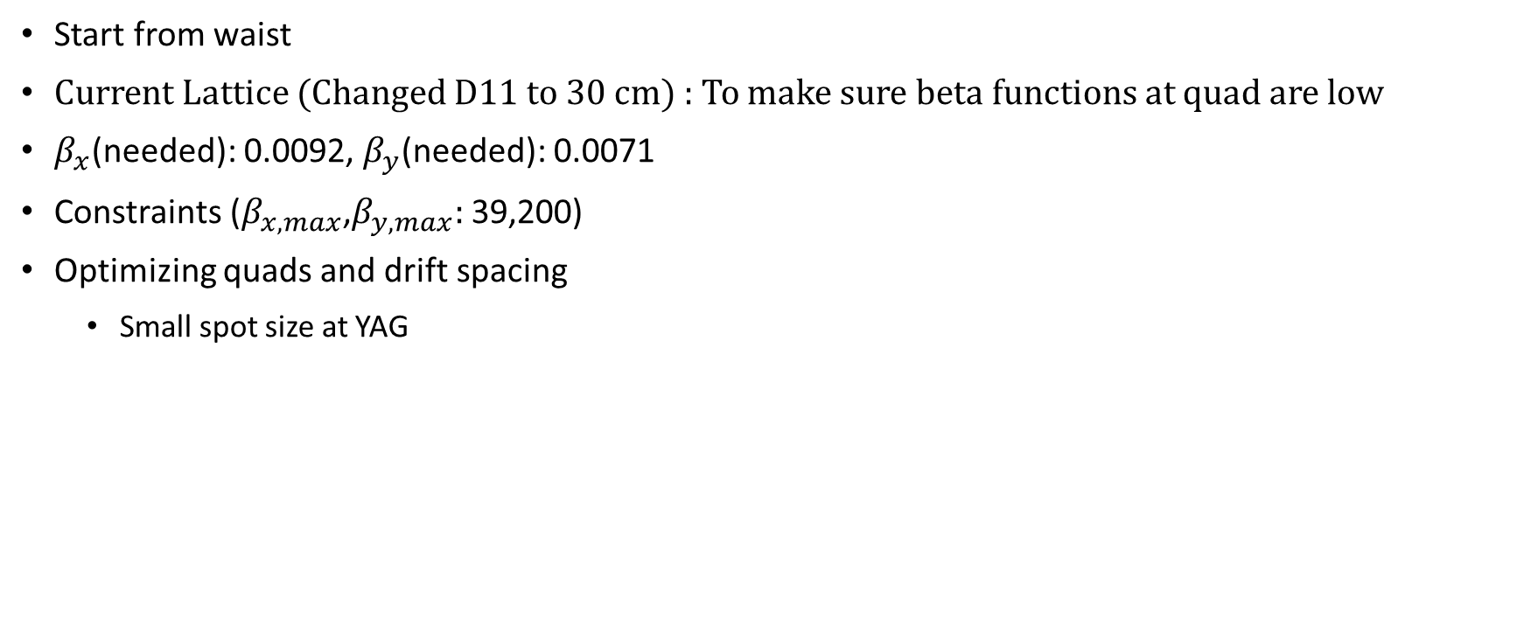
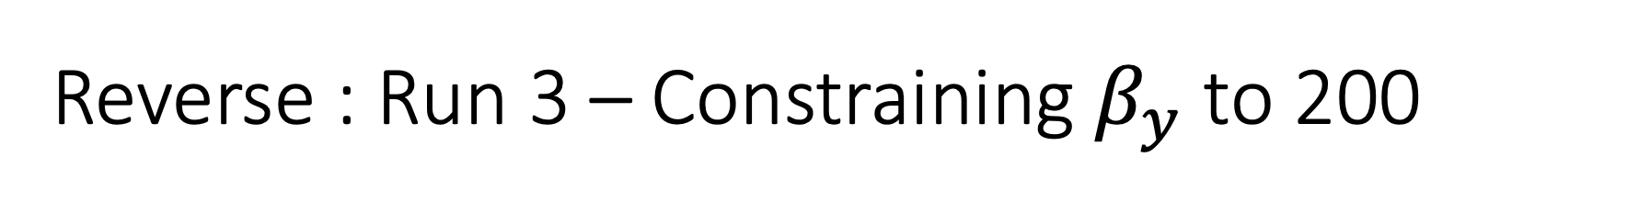
Reverse : Run 3 – Constraining $β_{y}$ to 200
Start from waist
Current Lattice (Changed D11 to 30 cm) : To make sure beta functions at quad are low
$β_{x}$(needed): 0.0092, $β_{y}$(needed): 0.0071
Constraints ($β_{x,max}$,$β_{y,max}:$ 39,200)
Optimizing quads and drift spacing
Small spot size at YAG

Slide 4

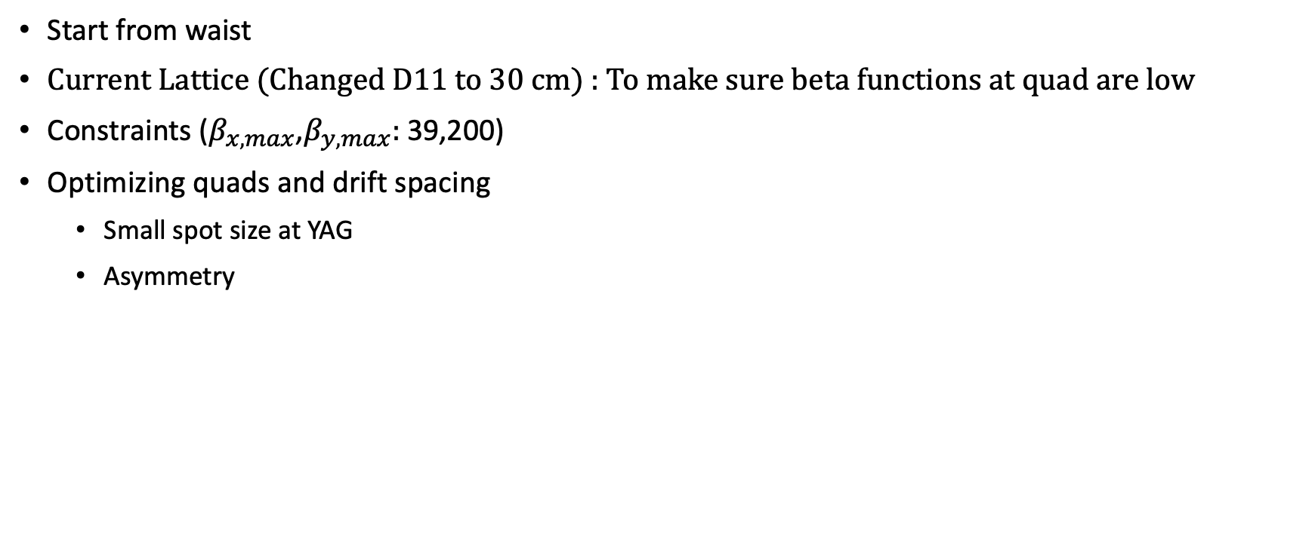
Reverse: Run 4 – Matching to initial Twiss parameters
Start from waist
Current Lattice (Changed D11 to 30 cm) : To make sure beta functions at quad are low
Constraints ($β_{x,max}$,$β_{y,max}:$ 39,200)
Optimizing quads and drift spacing
Small spot size at YAG
Asymmetry

Slide 5
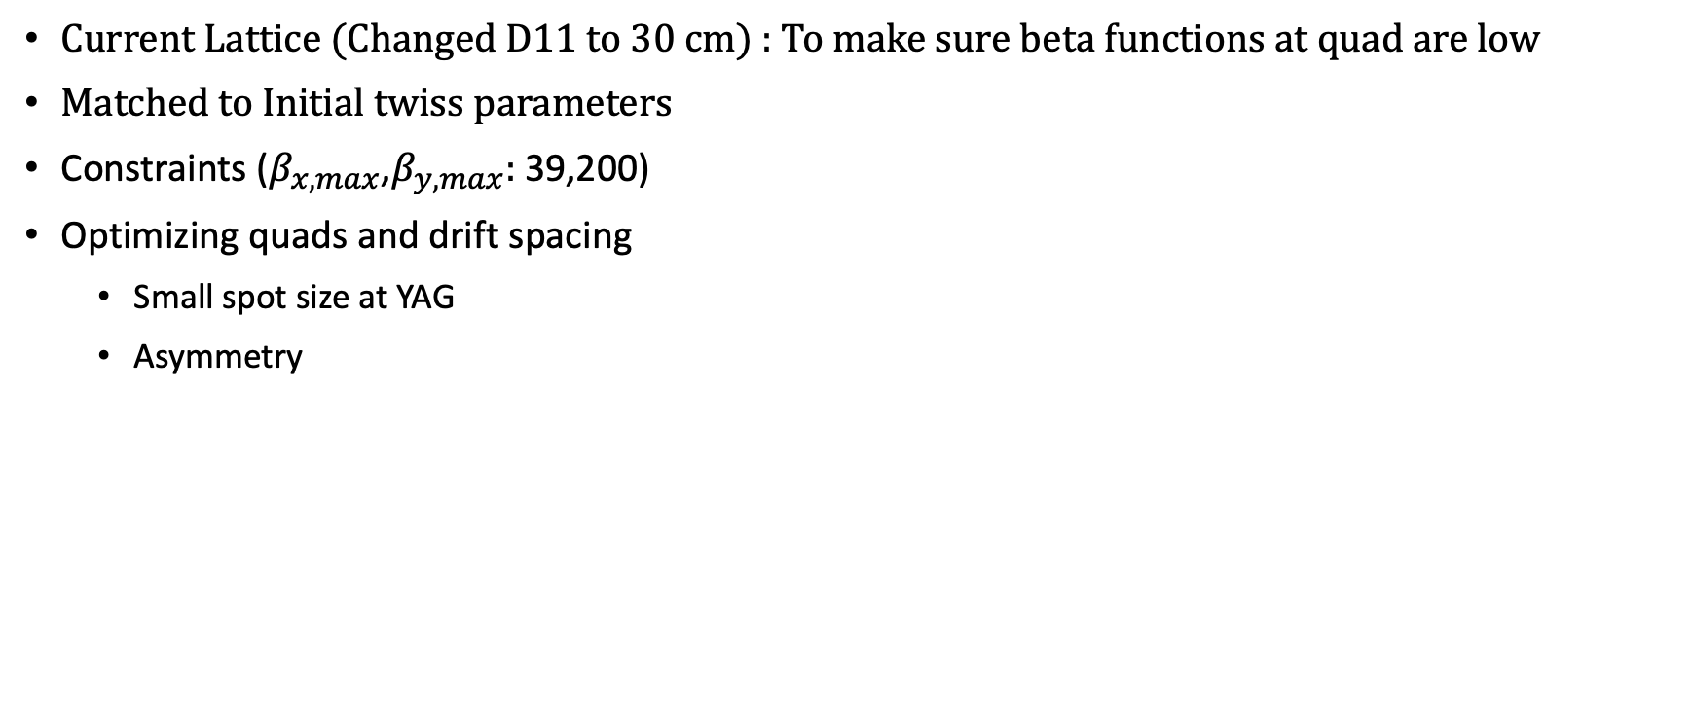
Reverse: Run 5 – Reverse matching to initial Twiss parameters but asymmetric spot size
Current Lattice (Changed D11 to 30 cm) : To make sure beta functions at quad are low
Matched to Initial twiss parameters
Constraints ($β_{x,max}$,$β_{y,max}:$ 39,200)
Optimizing quads and drift spacing
Small spot size at YAG
Asymmetry

Slide 6
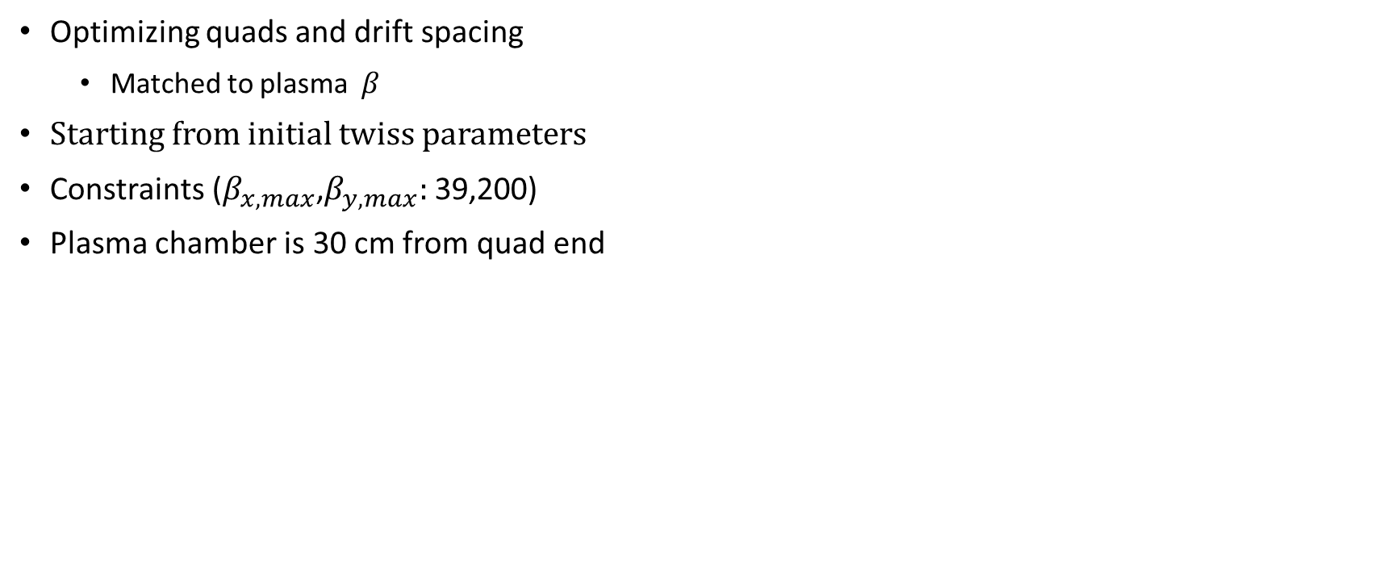
Forward: Run 6 – Matching to plasma parameters
Optimizing quads and drift spacing
Matched to plasma $β$
Starting from initial twiss parameters
Constraints ($β_{x,max}$,$β_{y,max}:$ 39,200)
Plasma chamber is 30 cm from quad end

Slide 7
Emittances (3rd order tracking)
Energy spread : 33 keV
Increases with increase in energy spread

Slide 8
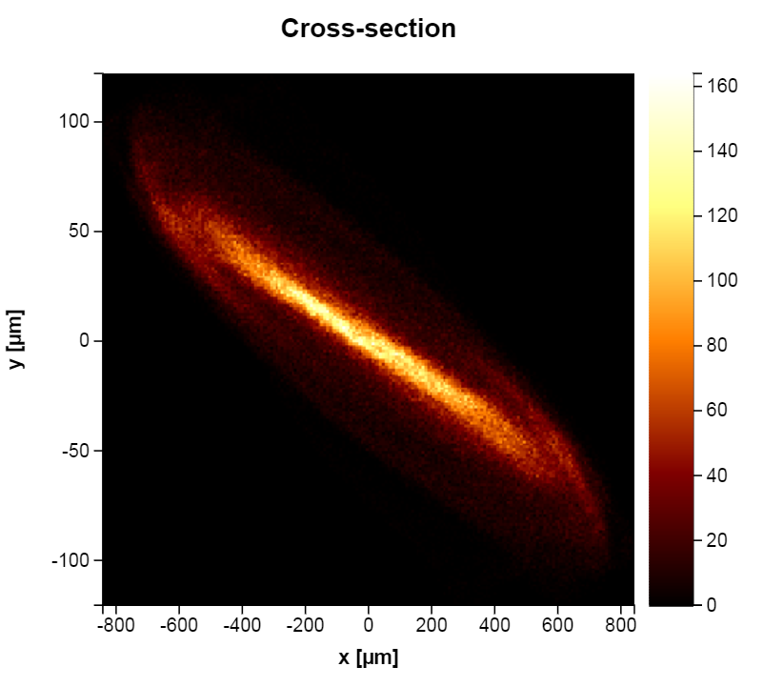
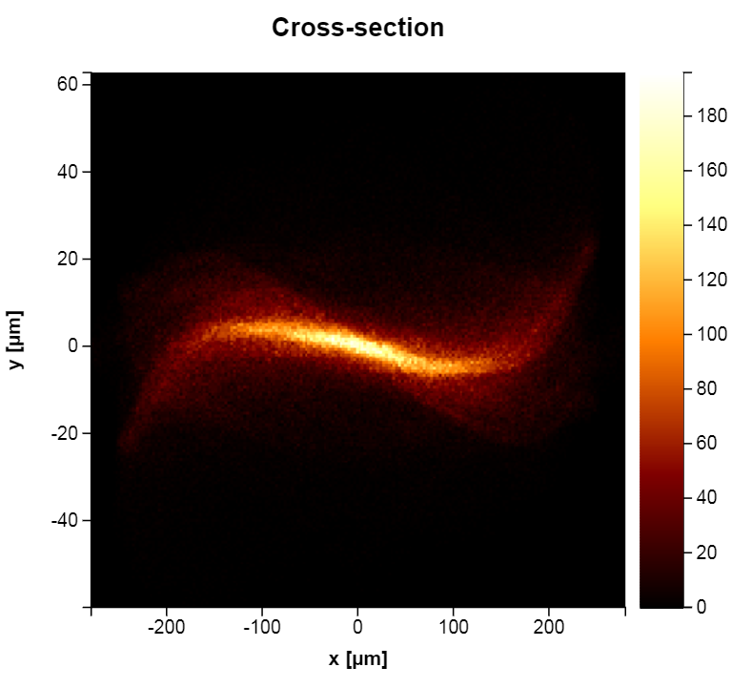
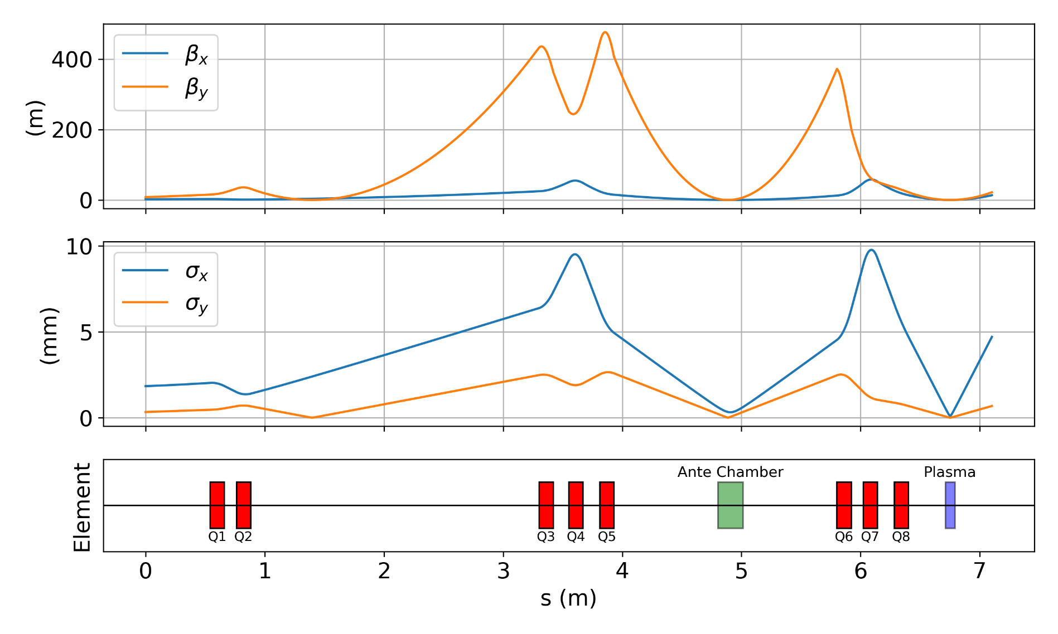
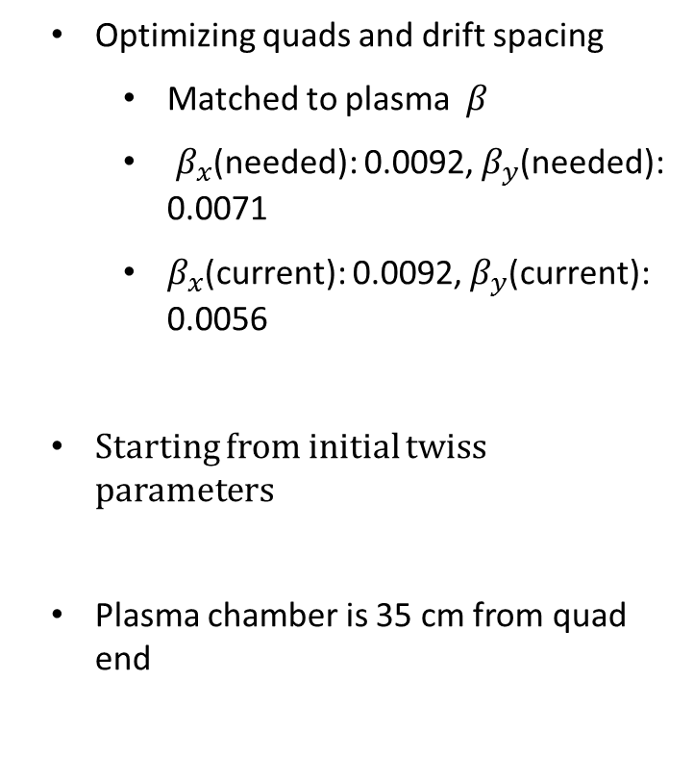
Forward: Run 11 – OPAL simulated beam
Optimizing quads and drift spacing
Matched to plasma $β$
$β_{x}$(needed): 0.0092, $β_{y}$(needed): 0.0071
$β_{x}$(current): 0.0092, $β_{y}$(current): 0.0056
Starting from initial twiss parameters
Plasma chamber is 35 cm from quad end

Slide 9
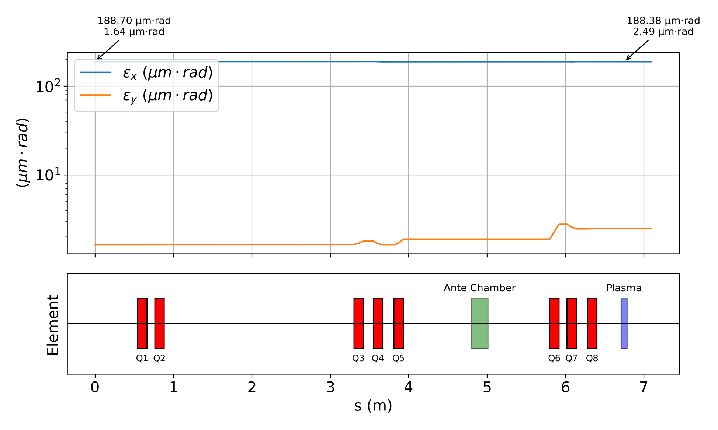
Run 11 : Emittances (3rd order tracking)
Energy spread : 33 keV
Increases with increase in energy spread

Slide 10
Existing AWA beamline
YAG
YAG
YAG
YAG
cube
22.85
25.13
20.3
20.87
23.62
24.13
25.99
26.69
27.3
27.64
27.98
21.08
23.87
26.34
(in m)
Experimental setup - FBPWFA
Needs to be modified
Slit
YAG
YAG
Window
plasma
20.3
22.85
20.87
23.62
24.13
25.13
26.12
26.60
27.01
27.31
21.09
23.87
26.34
(in m)

Slide 11
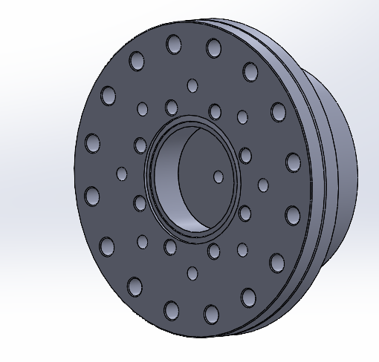
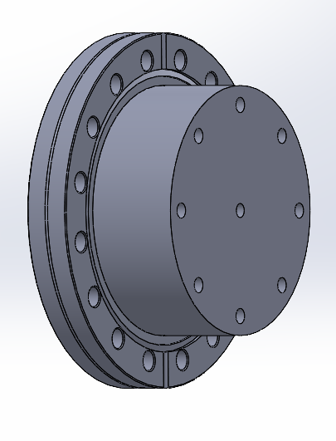
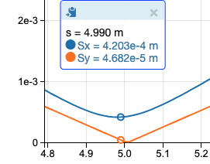
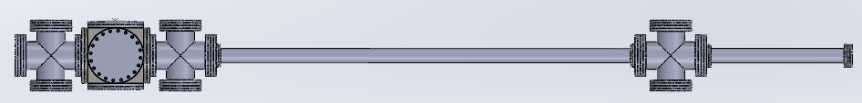
Apertures
6mm diameter, 40 mm length
Removable if elliptical apertures are needed
This could further enhance vacuum capability
Can be installed at three locations
Exit of plasma chamber
Entrance and exit of Ante chamber
5 mm
4 cm
5 mm
4 cm
10 mm with taper
3 cm

Slide 12
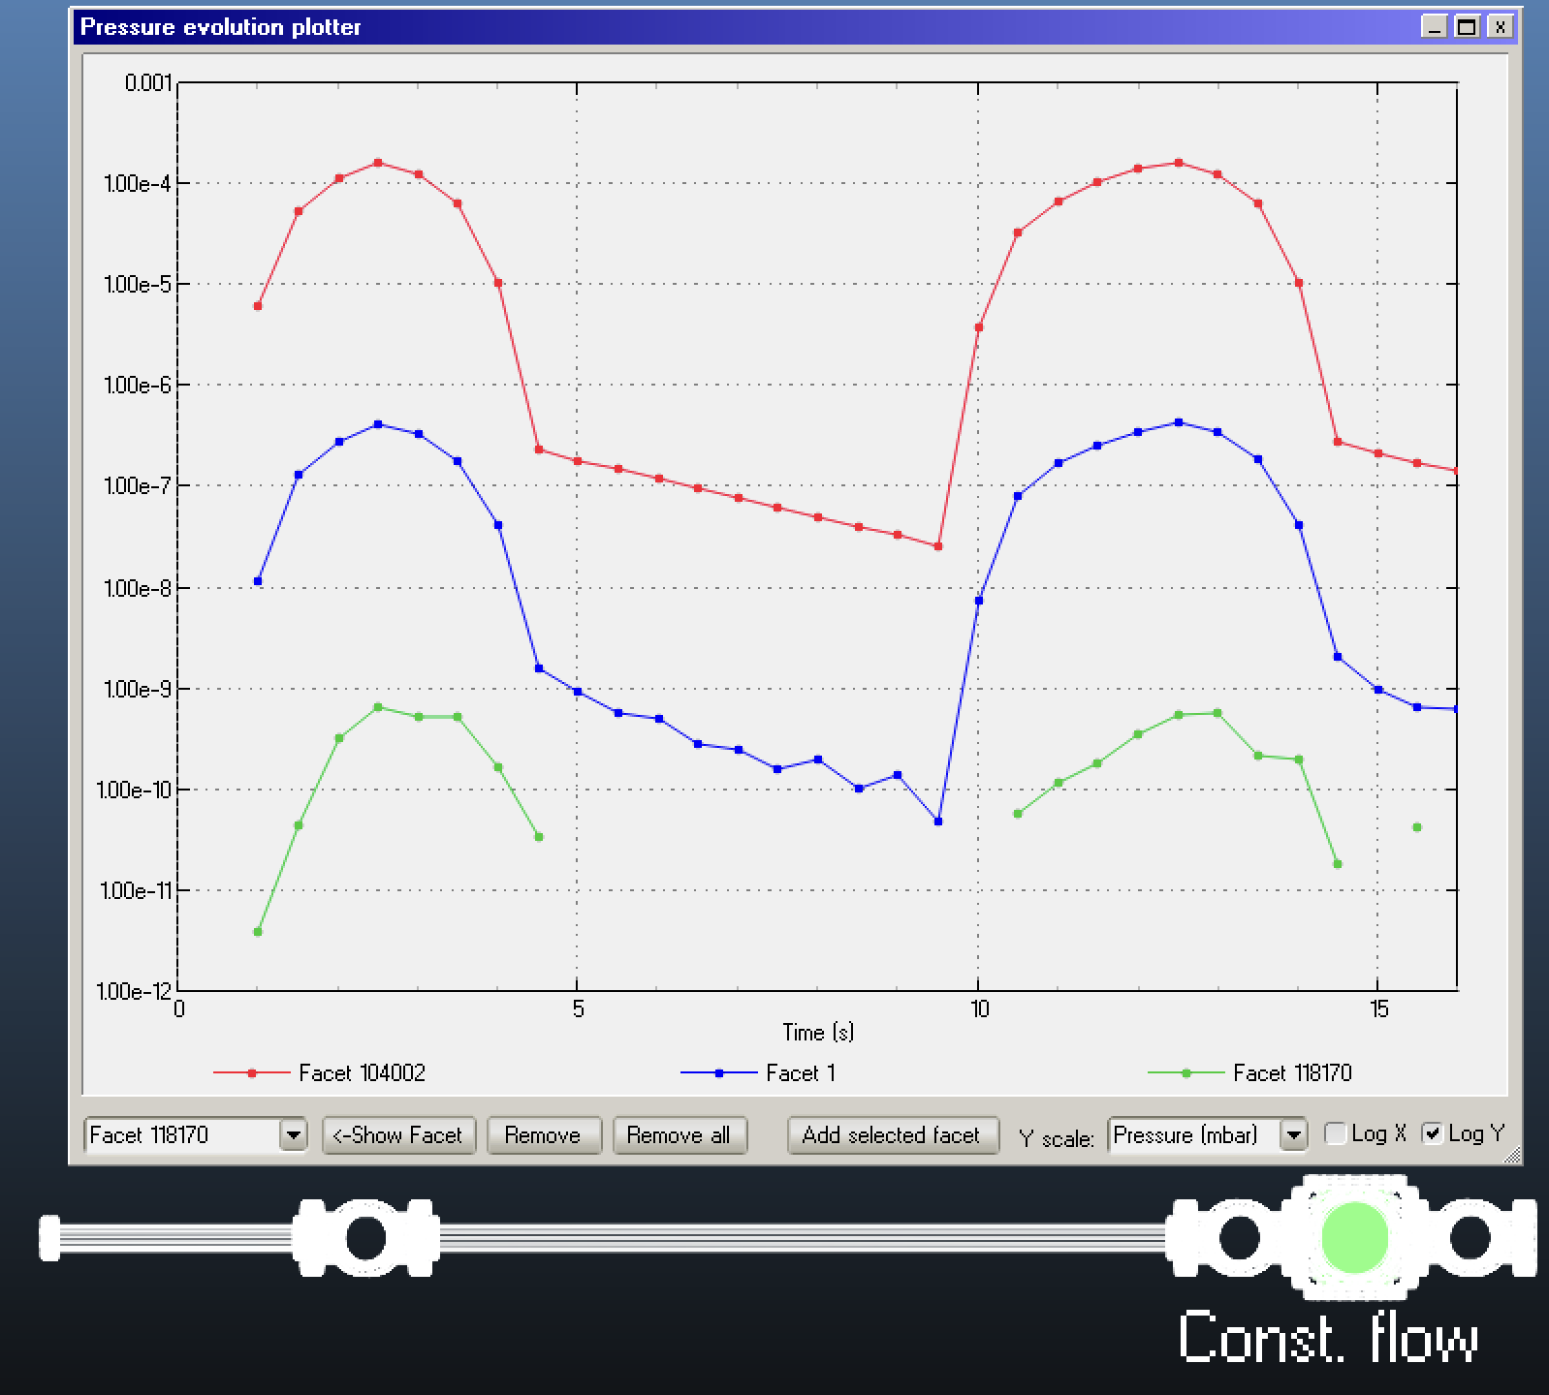
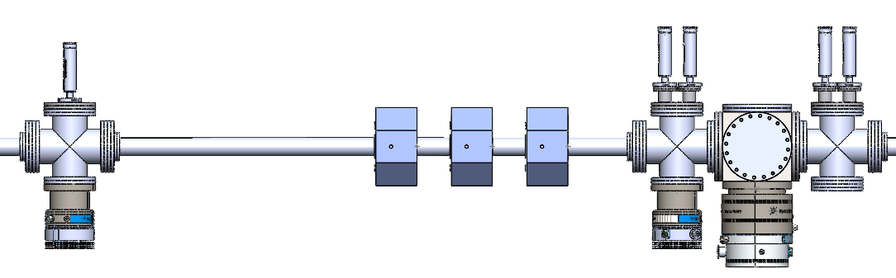
Molflow
Molflow simulations show that using these apertures, we could get 1e-9 mbar at the Ante chamber
Does require 3 turbo 300 l/s pumps but this is before third aperture
One of the sections could be tested at AWA before the beamline installation

Slide 13
Molflow
Molflow simulations show that using these apertures, we could get 1e-9 mbar at the Ante chamber
Does require 3 turbo 300 l/s pumps but this is before third aperture
One of the sections could be tested at AWA before the beamline installation

Slide 14
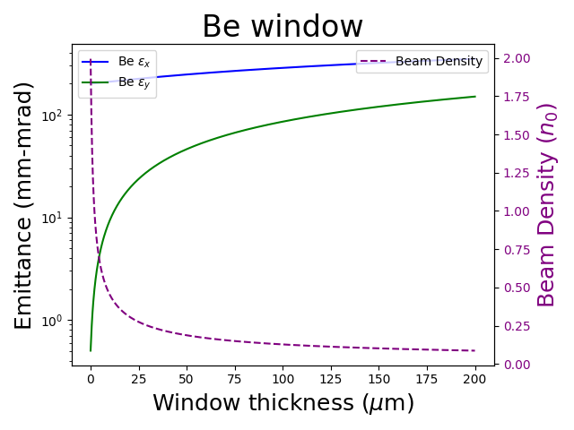
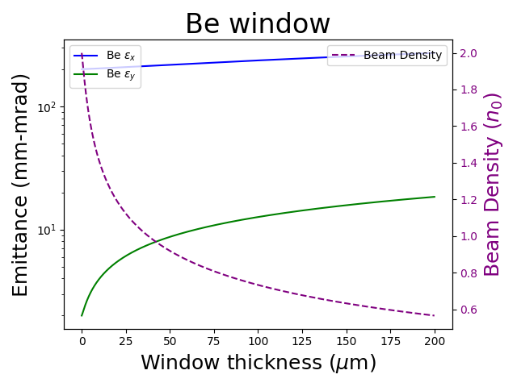
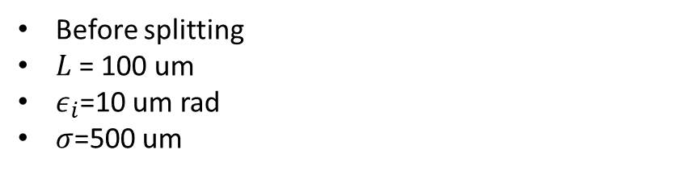
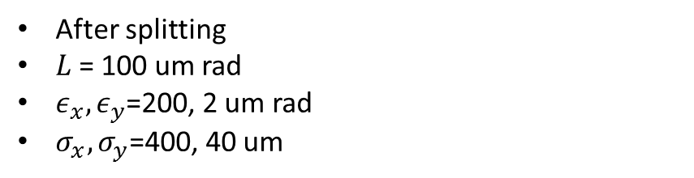
Scattering (Be window)
Before splitting
$L$= 100 um
$ε_{i}$=10 um rad
$σ$=500 um
After splitting
$L$= 100 um rad
$ε_{x},ε_{y}$=200, 2 um rad
$σ_{x},σ_{y}$=400, 40 um

Slide 15
Flat beam experiment
Flat beam created (330:5 um rad) at AWA
Need to learn OPAL to optimize matching solenoid
Molflow sims (Finalize setup)
Pietro has a pump, Phillipe could get a pump from APS
Elliptical apertures
Start AWA training (4 months)
Work on diagnostics – Downstream of chamber
Theory
Propagation needs to be completed for paper
Finite confocal elliptical sheath (Yunbo)
Theory
Interest shown by DESY as they have an asymmetric emittance ratio (2:1)
Asymmetric drivers used in many collider talks
Special interest in ion motion and how it focuses witness
No talk off ellipticity of bubble

Slide 16
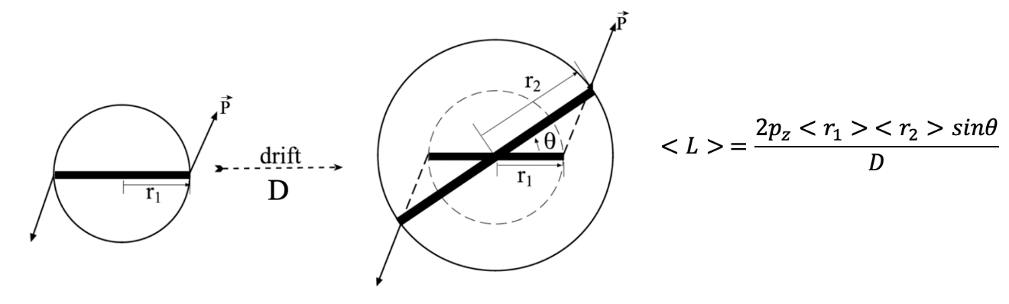
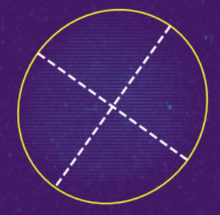
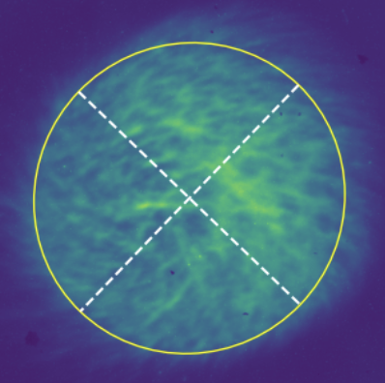

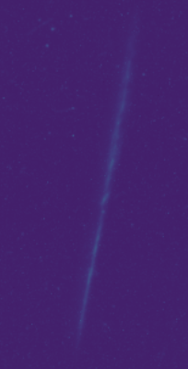
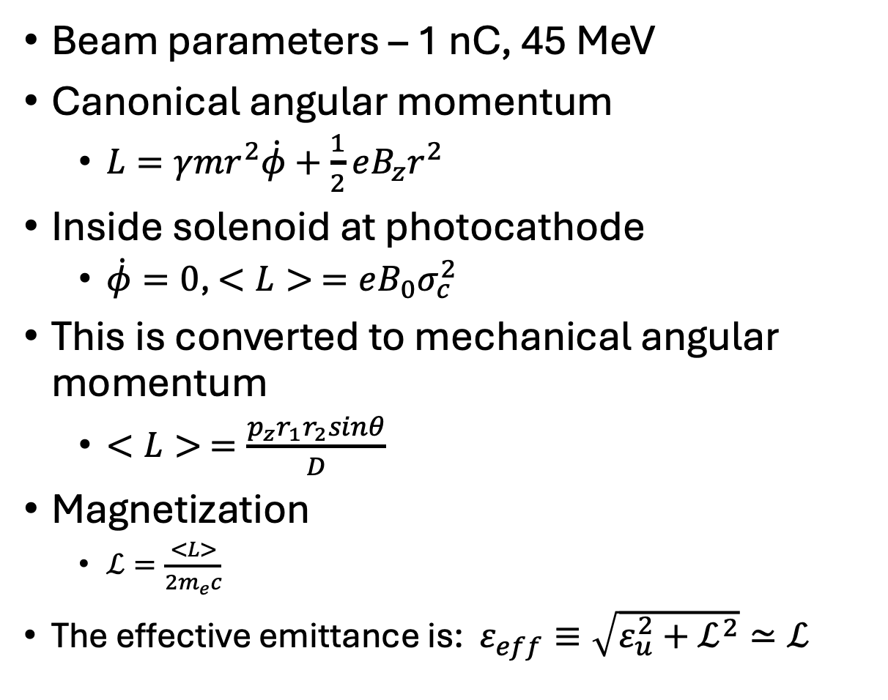

First runs - Magnetized beam ($ℒ$)
CAM dominated beam
Screen1
Beam parameters – 1 nC, 45 MeV
Canonical angular momentum
$L=γmr^{2}\dot{φ}+\frac{1}{2}eB_{z}r^{2}$
Inside solenoid at photocathode
$\dot{φ}=0$, $<L> =eB_{0}σ_{c}^{2}$
This is converted to mechanical angular momentum
$<L> =\frac{p_{z}r_{1}r_{2}sinθ}{D}$
Magnetization
$ℒ=\frac{<L>}{2m_{e}c}$
The effective emittance is: $ε_{eff}≡\sqrt{ε_{u}^{2}+ℒ^{2}}≃ℒ$
Drift
D
Y. Sun et al,
PRSTAB (2004)
Screen2
Uncorrelated emittance

Slide 17
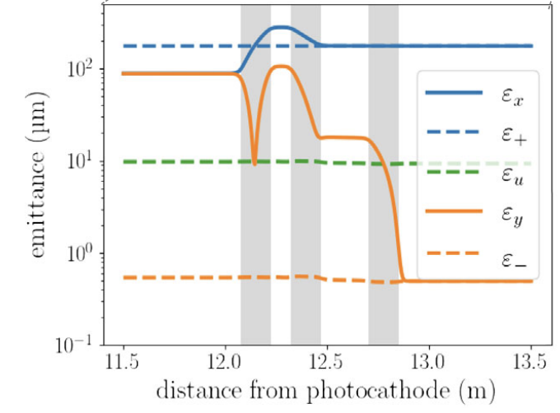
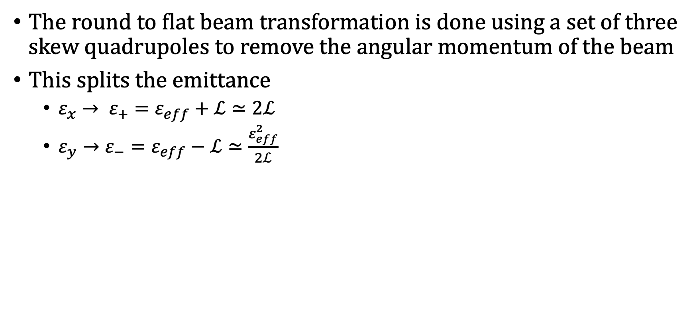
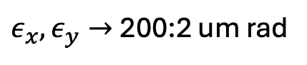
First runs - Round-to-Flat beam transformation
The round to flat beam transformation is done using a set of three skew quadrupoles to remove the angular momentum of the beam
This splits the emittance
$ε_{x}→ ε_{+}=ε_{eff}+ℒ≃2ℒ$
$ε_{y}→ε_{−}=ε_{eff}−ℒ≃\frac{ε_{eff}^{2}}{2ℒ}$
$ε_{x},ε_{y}→$200:2 um rad
T. Xu et al,
PRAB 2022
SQ1
SQ2
SQ3
Skew quadrupoles
YAG
YAG

Slide 18
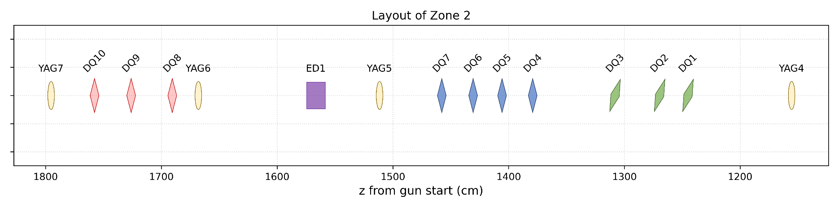
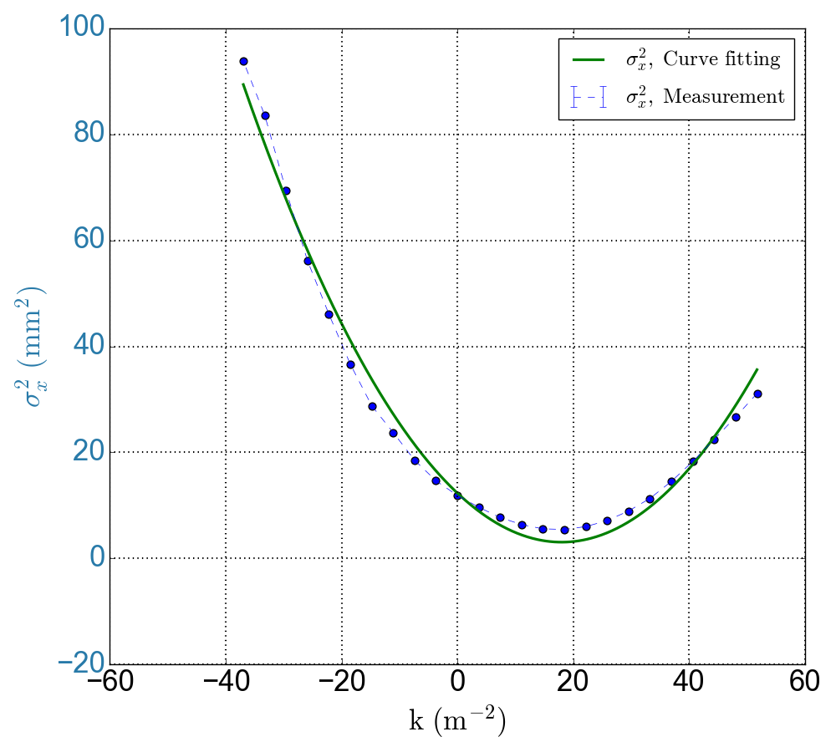
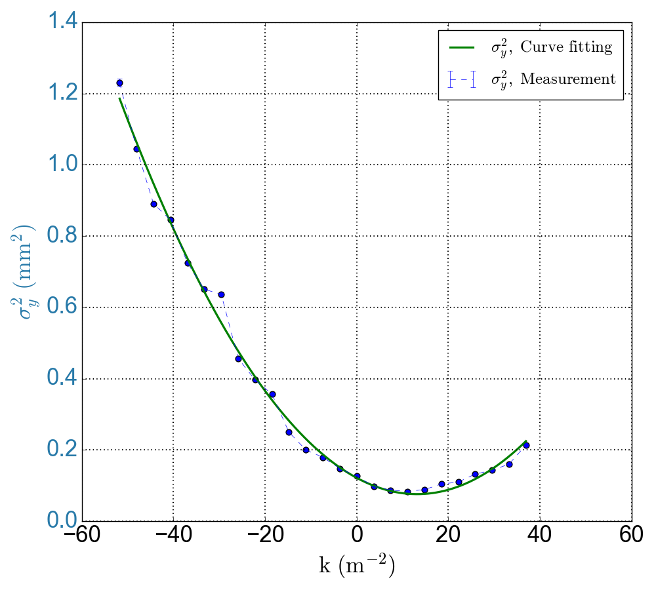
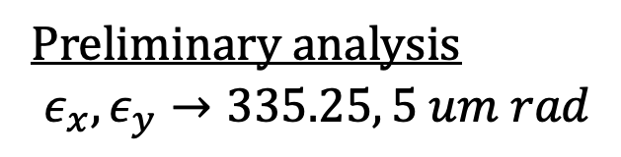
First runs - Quad scan measurement
Preliminary analysis
$$ε_{x},ε_{y}→335.25, 5 um rad$$

